Slide 1
Professional Practices
Software House Structure

Slide 2
Week 8 Lec:15
Anatomy, Introduction and Types of Software Companies
Common Roles in Software Company

Slide 3
What is Anatomy?
Study of
Structure
Organization
Internal working
Hierarchy chart

Slide 4
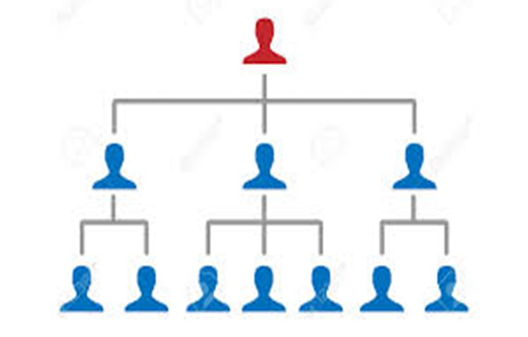
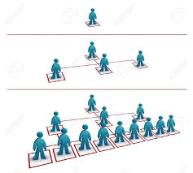
Anatomy may look like

Slide 5

Or like this… There are teams out there!

Slide 6
Introduction
A software company is a company whose primary products are various forms of software, software technology, distribution, and software product development.
A software house is a company that primarily provides software products. These companies may specialize in business or consumer software or software-as-a-service (SaaS) products.
The common definition is that the company is mainly invested in developing and distributing software products.

Slide 7
Introduction
A company that writes and cells software (Cambridge Dictionary)
A company or set up that is committed to software development, testing and maintenance( based on observation of your instructor)
How you would like to define it based on your knowledge, observation and/or experience?

Slide 8
Types
There are many types of software companies and there is so much diversity in software development industry
There are a number of different types of software companies:
Project oriented companies
Product oriented companies
IT service providers
Software enterprises
A software house can have multiple qualities at time as well. Say, for example, product oriented and project oriented divisions/ teams may co-exist.

Slide 9
Project Oriented Companies
Projects are their lifeline !!
Search for project
Requirement Analysis and design
Modules assigned to developers/teams
Software release
Teams/developers move to new projects

Slide 10
Product Oriented Companies
Run on ideas!!
Create projects rather than hunting for them
Take up software product idea
Transform their idea into product
Once a product is live, bugs, new versions, even more ideas and product growth etc.
Make large profits by implementing their ideas.

Slide 11
IT Service Providers
Something other than software development finally exists as a major role in such kind of software companies.
Focus on business, income generation and software usage statistics mainly
Usually a part of large production unit.
Usually they don’t develop their software project/product and outsource it to the other project oriented companies.
Examples call centers, telecom services, network services, industries etc

Slide 12
Software Enterprises
Dedicated to some enterprises
Usually focus on what company wants, as usually enterprises now have their own software house/ team of developers.
From requirement to development and business analysis they are dedicated to what that enterprise needs.

Slide 13
Types of Software Companies (yet another view point)
Large and globally renowned companies e.g. Oracle, Microsoft, Adobe.
Involved in specialized small to middle sized software houses etc. You may think of the software organizations out there in your country.
SaaS providers e.g. Google, Facebook etc.
Software house dealing with bespoke (custom made) software.

Slide 14
Common Roles in a Software Company
CEO
Leaders
Network Engineers
Board of Directors
Founder
Database Designers
Marketing Officers
Graphic Designers
Project Managers
Quality Assurance Engineers
Developers
Data Entry Specialist
HR Manager
Chief Financial Officer
Chief Legal Officer

Slide 15
Common Roles in a Software Company…
Organizing a software company is very specialized type of management skill, where experienced persons can turn the organizational problem into a unique benefit. For example, having sub-teams spread in different time zones may allow a 24-hour company working day, if the teams, systems and procedures are well established. A good example is the test team in time zone 8 hours ahead or behind the development team, who fix software bugs found by the testers.

Slide 16
Common Roles in a Software Company…
A professional software company normally consists of at least three dedicated sub-teams :
Business analysts who define the business needs of the market
Software developers who create the technical specification and write the software
Software testers who are responsible for the whole process of quality management

Slide 17
Common Roles in a Software Company…
In bigger software companies, greater specialization is employed, and quite often there are also:
Technical writers who write all the documentation such as user guides
Release specialists who are responsible for building the whole product and software versioning
User experience designers, who are creating the design architecture based on business requirements,
user research and expertise in usability
Graphic designers who are normally responsible for the design of the graphical user interface.
Maintenance engineers who are behind two, three or more lines of support

Slide 18
Structure
The manager of a software company is usually called the Head Of Development (HOD), and reports to the stakeholders. He or she leads the sub-teams directly or via the managers/leaders depending on the size of the organization. Usually teams of up to 10 person are the most operational. In bigger organizations, there are in general two models of the hierarchy:

Slide 19
Structure…

Slide 20
Structure…

Slide 21
Structure…
All the teams are fully independent and they work separately on the different projects. The structure is quite simple and all the employees reports to one person, what make the situation quite clear however it is not a good solution in terms of knowledge exchange and optimal usage of human resources.
In this model there are dedicated managers/leaders for each main specialization, "renting" their people for particular projects led by product/project managers, who formally or informally buy the people and pay for their time. This leads to each private employee having two bosses – the product/project manager and the specialized "resource" manager. On one hand it optimizes the usage of human resources, on the other hand it may give rise to conflicts about which one manager has priority in the structure.
There are also a number of variants of these structures, and a number of organizations have this structure spread and split within various departments and units.

Slide 22
Methodologies
Software companies may use a number of various methodologies to produce the code. These can include:
The waterfall model, including project management methodologies like PRINCE2 or PMBoK
Agile software development, such as Extreme Programming and SCRUM
There are also some methodologies which combine both, such as the spiral model, Rational Unified Process (RUP)

Slide 23
Product Life Cycle
Regardless of the methodology used, the product life cycle always consists of at least three stages:
Design – including both the business and technical specification
Coding – the development itself
Testing – the quality management
At each stage, a different group plays a key role, however each type of role must be involved throughout the whole development process.

Slide 24
Product Life Cycle…
Analysts, after completing the business specification, manage the changing business situation to minimize the possibility of change over time. They also support both programmers and testers during the whole development process to ensure that the final product fulfills the business needs specified at the start. The process ideally puts business analysts as the key players during final delivery of the solution to the customer, as they are placed to provide the best business layer.
Programmers do the technical specification during the design phase, which is why they are called programmers/designers, and during testing time they fix bugs.
Testers complete the test scenarios during the design phase, and evaluate them during the coding phase.

Slide 25
System & Procedure

Slide 26
System & Procedure…
Well-run software companies possess various systems and procedures implemented and working internally across all the sub-teams. These include:
Business Analysts
Modeling tools like Sparx Systems Enterprise Architect or IBM’s Rational Rose
Programmers
Version Control Systems and software versioning procedures
Code analysis tools and coding standards, validated manually or automatically
Deployment mechanisms

Slide 27
System & Procedure
Testers
Bug tracking systems
Test automation tools
Performance and stress test tools
Project/Product managers
Enterprise Project Management (EPM) systems and procedures
e.g. Product portfolio management (PPM)
Change management systems and procedures
There are also Application Lifecycle Management (ALM), which embed some of these functionalities in one package and are used across the groups. They are delivered from various vendors like Borland, ECM or Compuware.

Slide 28
Efficiency Audits
Well-established software companies typically have some way of measuring their own efficiency. This is usually done by defining the set of key performance indicators, such as
The average number of bugs done by the developer per unit of time or source lines of code
The number of bugs found by tester per test cycle
The average number of test cycles until Zero Bug Bounce (ZBB)
The average time of test cycle
Estimated time of task comparing to the real time of the task (exactitude of planning)
Number of corrections to the baseline

Slide 29
References
https://churchjobfinder.com/seven-common-elements-healthy-team-ron-edmondson/
https://techbeacon.com/app-dev-testing/13-ways-motivate-software-engineers
https://www.forbes.com/sites/brentgleeson/2019/03/14/15-characteristics-of-high-performance-teams/?sh=5916f6cc6ae0

Slide 30
Thank you!

